Slide 1



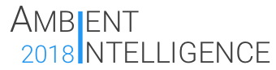
Nice To Meet You
Group 7
Ambient Intelligence Course
A.Y. 2017-18
https://ami-2018.github.io/NTMY/

Slide 2
Introduction
NTMY team

Slide 3
What is NTMY
NTMY is an Ambient Intelligence system that aims to help students in university residences to meet new friends by letting the users organize thematic events.
The goal of the project is to build a system that can be used in university residences to smartly organize events in order to let people meet others with the same interests. For this purpose, it makes use of different kinds of electronic devices such as PCs, mini computers, smartphones and wearables, all of which contribute to solve different problems that can be experienced during the organization of an event.
- Taken from Vision and Goal

Slide 4
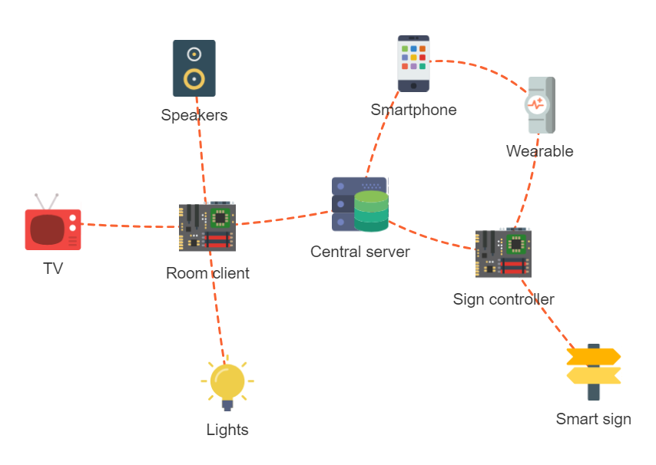
System architecture

Slide 5
NTMY Team
Alessio Ciarcià
SW developer
Matteo Corain
SW developer
Andrea Cossio
HW developer
Raffaele Tuzzo
SW developer
Wear app
Panel app
Server app
Client app
Smartphone app
Panel design
Panel app

Slide 6
Server architecture
Matteo Corain

Slide 7
Server main functions
Data storage
The server stores all the data regarging the users, the events and the rooms
Events allocation
The server is capable of the smart allocation of the rooms based on the events’ characteristics
API interface
The server presents an HTTP REST API-based interface to communicate with the other components of the system

Slide 8


Data storage
Uses Python SQLAlchemy support library, with SQLite as the database backend
Manages data about users, rooms, events and their relationships
The data model is organized in several subpackages, all containing classes whose objects are mapped from and to the database

Slide 9
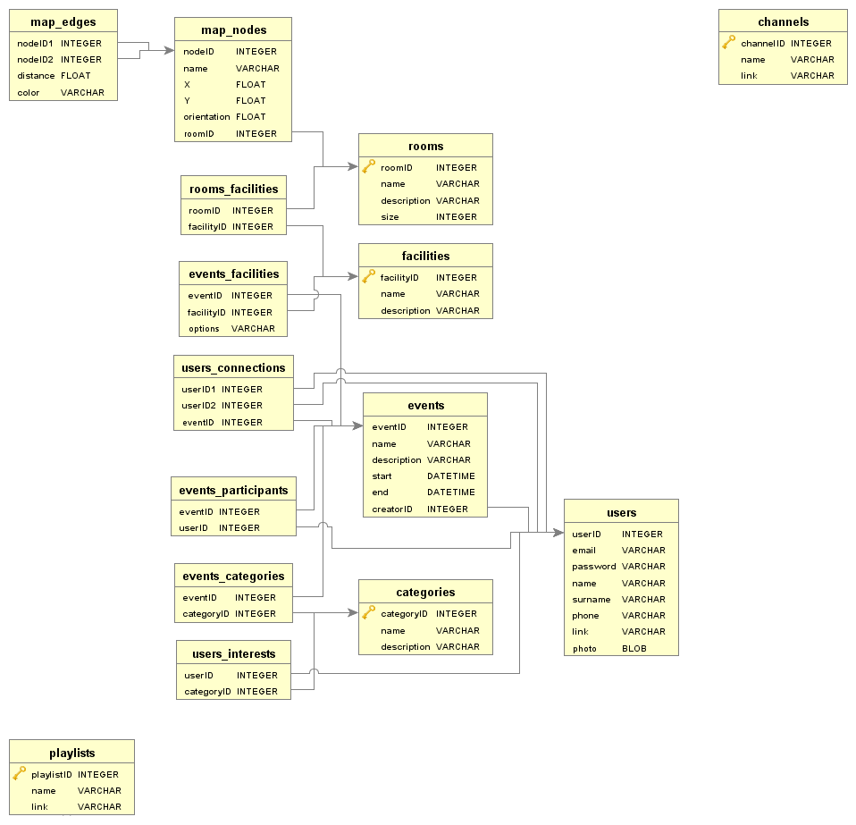
Data model
Main components:
Package standard:
User, Room, Event
Category, Facility
Package relationships:
UserConnection, EventParticipant
EventFacility, RoomFacility
EventCategory, UserInterest
Package map:
Node, Edge
Package media:
Channel, Playlist

Slide 10
Events allocation
Generates the daily schedule matching rooms and events
Uses a brute force optimization method
It is capable of optimizing different target functions
Makes sure that events fit the rooms and don’t overlap
Run asynchronously in a separated thread

Slide 11
Allocation process
The allocate_rec function generates all the permutation of n integers (being n the number of the rooms, considering also 0 as the special value meaning «the event will not be scheduled») in k position (being k the number of the daily events) via recursion techniques
Once a permutation has been calculated, a DailySchedule object is generated; if the schedule is valid (events fit the assigned rooms and do not overlap), it is passed to the TargetFunctionsSet object
The TargetFunctionsSet calculates the value of all the TargetFunction objects for the given schedule and compare them with the ones of best solution found until that point
If the schedule is better, the best solution is updated and, at the end of the process, the best daily schedule overall is produced

Slide 12

API interface
Uses Flask as the HTTP server
Exposes APIs to access data about users, rooms, events, media contents, graph nodes
Access to data is restricted only to registered users
Designed using the Google Developers guidelines

Slide 13
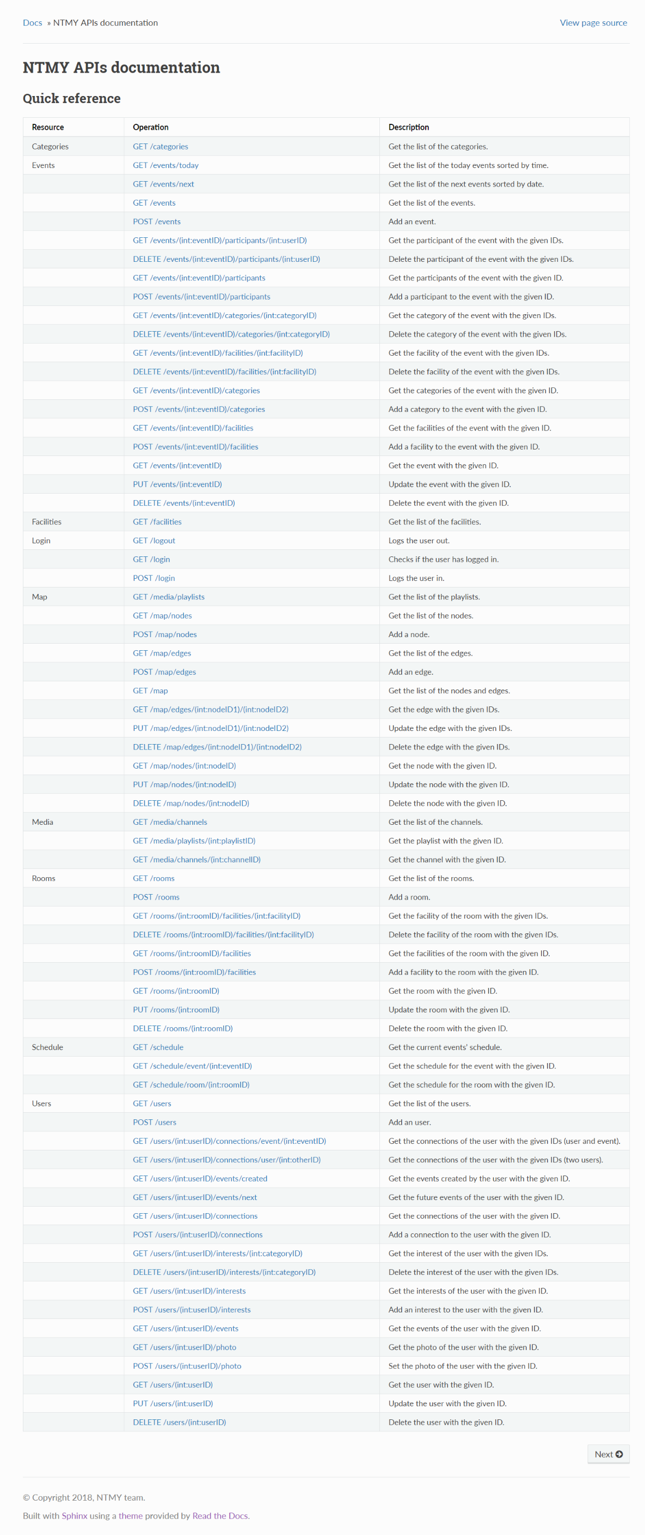
Main routes
/login
/users
/rooms
/events
/schedule
/media
/map
The full documentation is on the Github repository

Slide 14
Room clients
Matteo Corain

Slide 15
Room clients activities
Login into the server
Get the information on the next event
Set the lights with the events color
Set the music or TV player
Wait until the event is finished
Loop for the following event

Slide 16

Used libraries
Requests
Login phase and server information exchanging
Subprocess
OMXPlayer management
Philips Hue control
Pafy
Youtube music playlist fetch
TV channels fetch

Slide 17

Lights management
Philips Hue bulbs controlled via the HTTP REST API
All the interaction takes place in a LightManager object
The color is obtained from the events’ schedule
Possible to convert a RGB color with the rgb_to_hue function
Possible to set all or a subset of the lights in the room

Slide 18
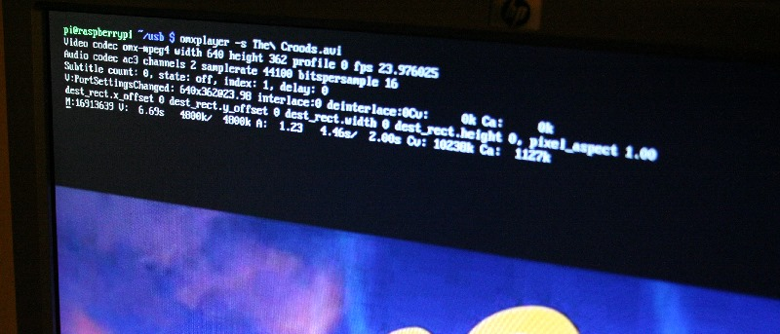
Media management
OMXPlayer is used as the player backend for its compatibility with Raspberry Pi boards, running as a subprocess
The interaction takes places in a Player object
TV channels (RAI) are fetched in m3u8 files faking the User Agent to the one of a normal browser
Music playlists are fetched in m3u8 files through pafy library

Slide 19
NTMY Android app
Andrea Cossio

Slide 20
NTMY Wear app
Alessio Ciarcià

Slide 21
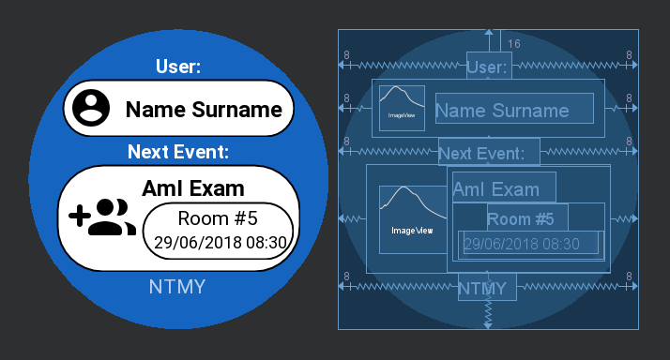
Step 1: Design
Once opened it shows:
User’s name and surname
Event’s informations
Event’s related color in the background.

Slide 22
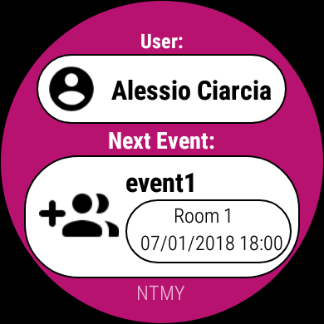
Step 2: Load data
When user runs the wear app:
Wear sends a message to the phone in order to obtain the data
If the phone is connected to the server (user logged) sends back the requested data and the wear update the layout with real data.
Otherwise if the phone can’t reach the server, the wear will shows the default data ( previous slide ).

Slide 23
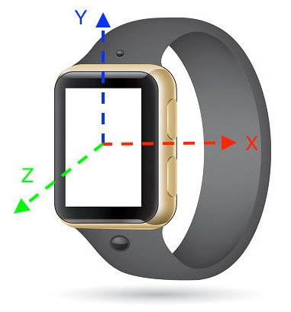
Step 3: Handshake Detection
Assumptions & limitations:
An handshake is here considered as a significant acceleration on wear’s Y axis.
The detection must be calibrated in order to not associate ordinary user’s movement to handshake.
On the other hand it must be sensitive enough not to lose any handshake

Slide 24
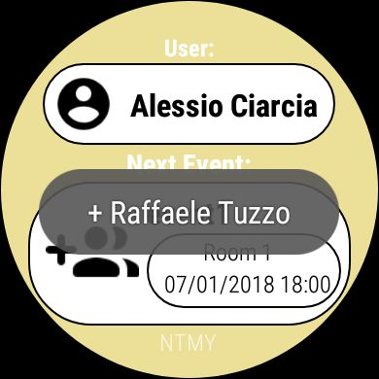
Step 3: Handshake Detection
Algorithm:
When an handshake is detected:
Check if is passed enough time since the last one.
Send a message to the phone.
The phone searches the other smartwatch (note: smartwatches only have «always detectable» enabled) and if it is found, phone sends back to the wear the fullname of the detected user (smartwatch).
The smartwatch and the phone will show a toast containing the user’s fullname.

Slide 25
Routing
Alessio Ciarcià

Slide 26
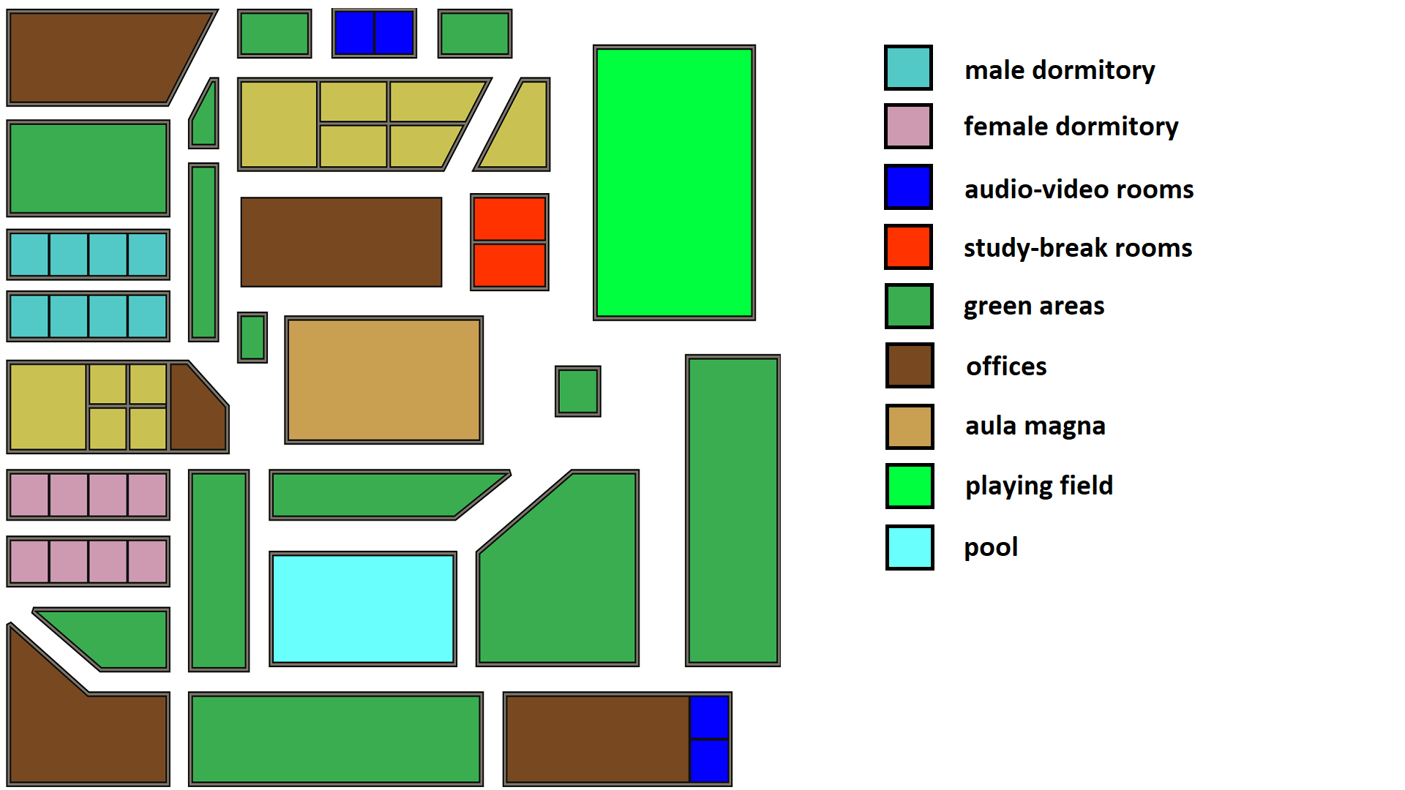
Step 1: Design college model
Our imaginary college has been designed taking into account that:
Bookable rooms are not all in the same location
The streets do not form a perfect grid so that the routing prediction is not trivial.

Slide 27
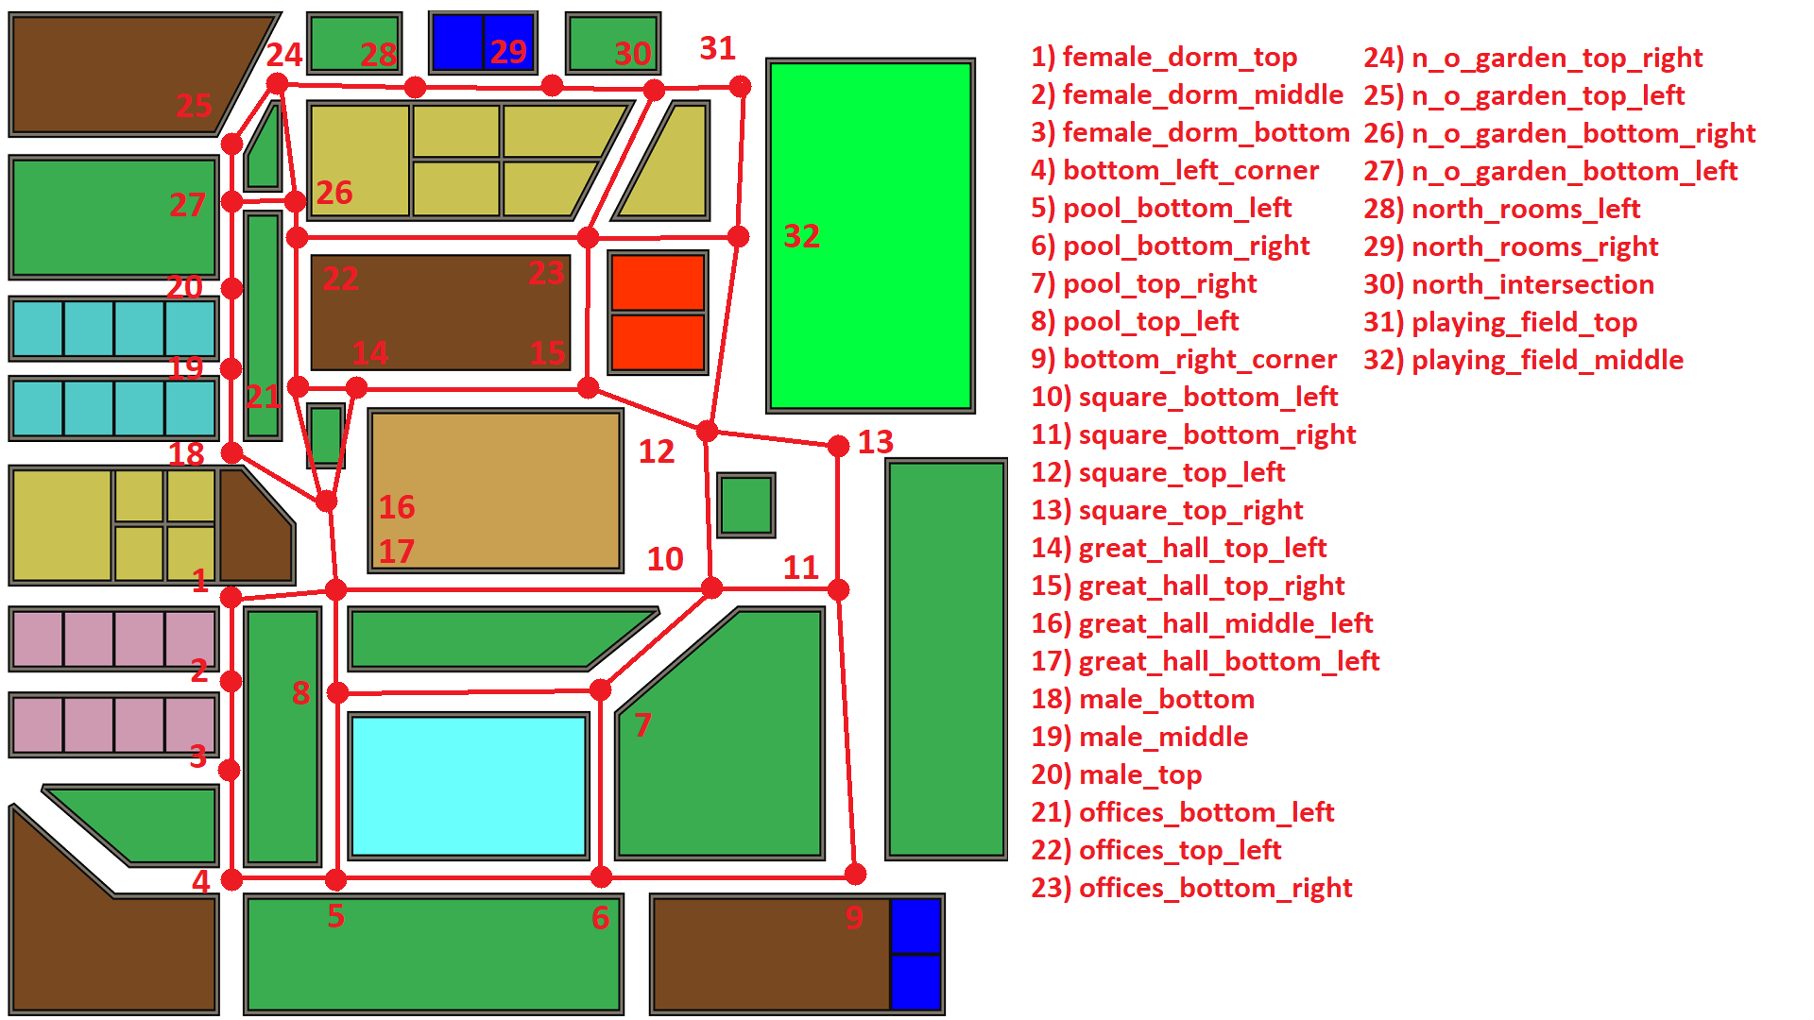
Step 2: Graph model
From the college model was built a graph over it:
There are 32 nodes covering almost all the crossroads.
In each nodes there is a direction panel.
A node has at most 4 edges => 4-directions panel

Slide 28
Step 3: Programming
Tools:
Three libraries were used mainly:
Networkx : To create and handle the graph.
Sqlite3: To create and connect to a database containing graph’s nodes and edges
Pandas: To read the database and handle the data structure in an easier way.

Slide 29
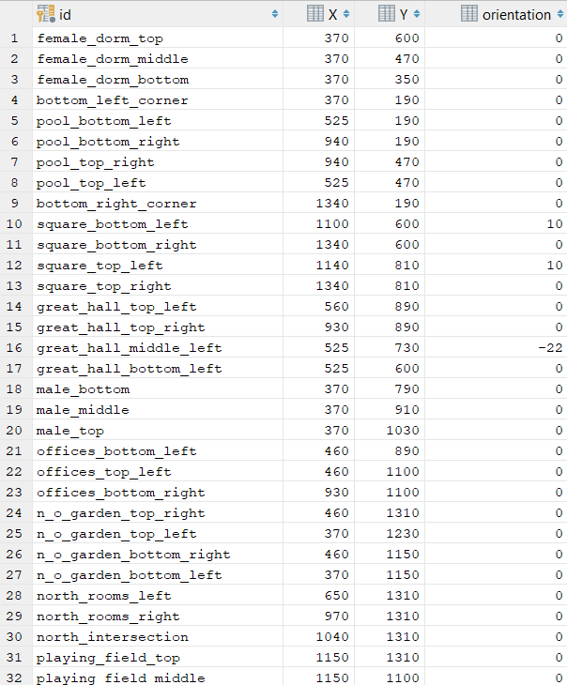
Step 3: Programming
Process: Database creation.
The database contains two tables, one for nodes and another for edges.
Each node has a string identifier, coordinates and panel orientation (since not all the crossroads have orthogonal intersections or not all the streets are aligned with cardinal axes.
Each edge tuple contains the two nodes id and the length of associated stretch of road

Slide 30
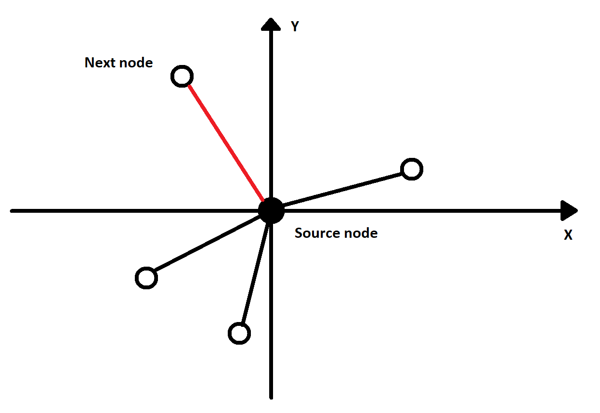
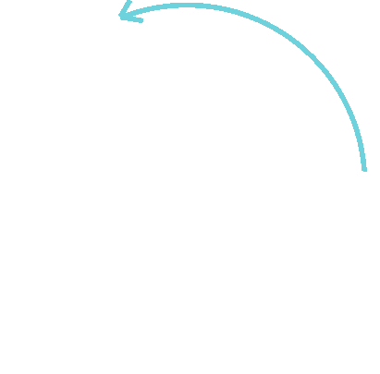
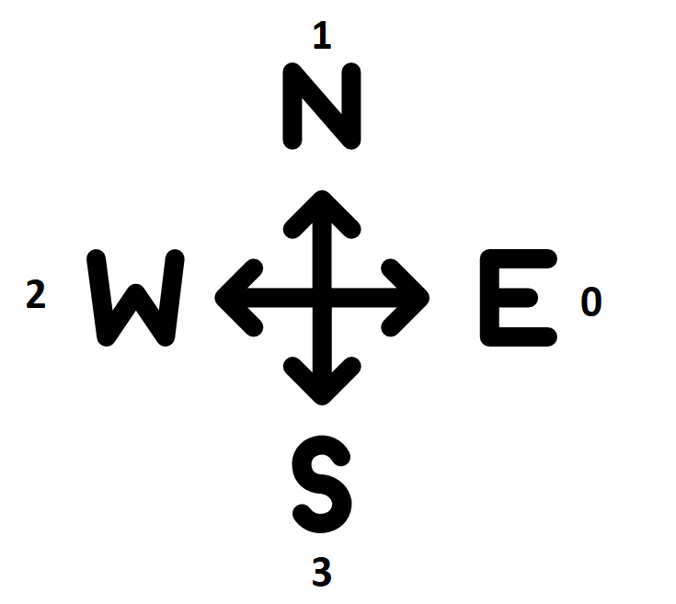
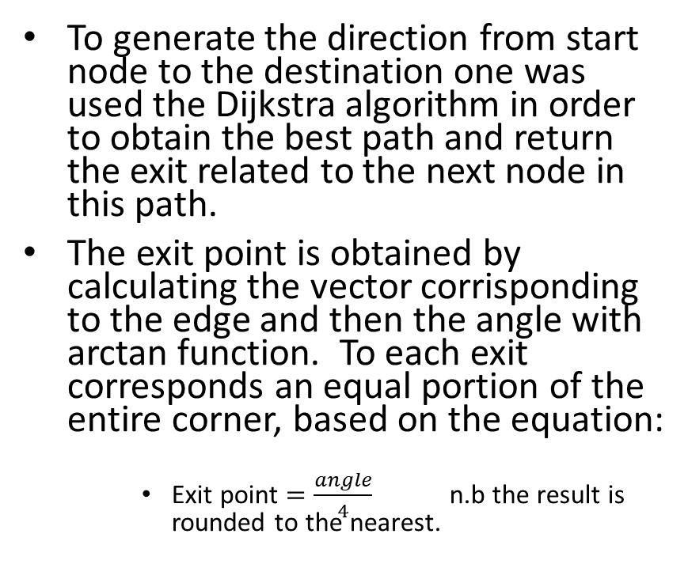
Step 3: Programming
Process: Strategy.
To generate the direction from start node to the destination one was used the Dijkstra algorithm in order to obtain the best path and return the exit related to the next node in this path.
The exit point is obtained by calculating the vector corrisponding to the edge and then the angle with arctan function. To each exit corresponds an equal portion of the entire corner, based on the equation:
Exit point $=\frac{angle}{4}$ n.b the result is rounded to the nearest.

Slide 31
Panels architecture
Raffaele Tuzzo

Slide 32
Demo time!
NTMY team

Slide 33
What you’ll see today
Event creation and joining
Room preparation
Directional panels
NTMY action

